Slide 1
HUMAN RIGHTS

Slide 2
What are rightS?
Rights are defined as normative rules that are set by legal jurisdiction and are owned by the people.
It is something that every human being deserves, no matter where it comes from, where it is born, or where it lives.
Generally, rights are written in-laws. On the basis of this, people can very easily defend their rights before the Court of Justice.
It is important to remember that rights are based on a set of behaviors that are accepted in agreement,
where also the responsibilities that each one has as a result of cooperation and mutual respect are raised.
Rights are not laws that allow individuals or governing bodies to do or say anything they desire.
They are the foundation or framework in which society as an entire structure is defined.
It is considered that rights are one of the pillars that allow the establishment of our society and culture.

Slide 3
WHAT ARE RESPONSIBILTIES?
Responsibilities are the civil duties that each citizen is supposed to fulfill. These responsibilities are believed to help make the country a peaceful and suitable place to live.
Rights and responsibilities are often complementary, and one is the derivation of the other. Take it this way; the constitution gives the citizens the right to life, liberty, and the pursuit of happiness; in return, the citizens are responsible for supporting and defending the Constitution.

Slide 4
BASIC DIFFERENCE BETWEEN RIGHT AND RESPONSIBILITIES
A right is a privilege granted by a governing body that is written into law.
A right can be defended or challenged in a court of law.
A responsibility is a duty or obligation that is accepted, or put into action.

Slide 5
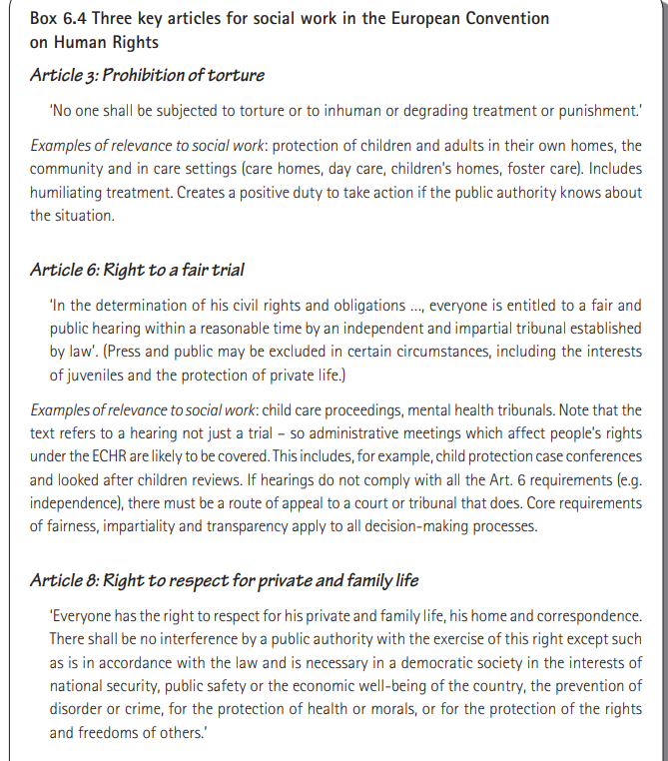

Slide 6
CHARACTERISTICS OF HUMAN RIGHTS
Human rights are universal in nature which means that they are given to every individual irrespective of his/her caste, creed, race, religion, nationality and place of birth.
These are inalienable rights. Many philosophers believe that these are natural rights given by God and cannot be taken away or changed by anyone.
These are indivisible and interdependent rights. If a government gives one right then it has to protect the other rights of its citizens. For example, it is the duty of government to protect the right of fair hearing and provide food, shelter and clean environment to its citizens in order to protect the right to life of its citizens.
They are inherent to each person and available since birth.
They are not lost if the man is not familiar with his rights or if he does not use his rights. For example if a person is not aware of his right to consult the advocate then it does not mean that his right is finished. It is then the duty of authorities to provide him with free legal aid or tell him his rights.
They protect the dignity and personality of humans. Rights like right to life, right to liberty, right against arbitrary arrest and punishment etc protect the dignity of a person.

Slide 7
TYPES OF HUMAN RIGHTS
The Universal Declaration of Human Rights did not precisely categorise human rights but mentioned 2 kinds:
Civil and political rights
Economic, social, and cultural rights
The rights that protect the life and personal liberty of a person are called civil rights. They are necessary to maintain the dignity of a person. These include rights like the right to life, liberty and security of a person, the right to privacy, the right to own property, freedom of thought, religion and movement.
Political rights are such rights that allow a person to participate in governmental activities. These include rights like the right to vote and the right to be elected. The nature of such rights is different, but they are interrelated to each other.

Slide 8
These rights are also called freedoms and guarantee a person the minimum necessities of life.
Right to social security (Article 22)
Right to work and choice of employment (Article 23)
Right to rest (Article 24)
Right to standard living and health (Article 25)
Right to education (Article 26)
Freedom to participate in cultural life (Article 27)

Slide 9
SUMMARIZING
Civil and political rights, such as the right to life, liberty, security, privacy, property, freedom of thought, conscience, religion, expression, and participation in government.
Economic, social, and cultural rights, such as the right to work, education, health, social security, family, and culture.
Moral rights, such as the right to dignity, respect, and integrity.
Group rights, such as the right to self-determination, minority rights, and indigenous rights.
Rights to development, such as the right to a fair and sustainable development of resources and opportunities.
Rights of women and children, such as the right to equality, non-discrimination, protection from violence, and empowerment
Universal Declaration of Human Rights | United Nations

